Slide 1
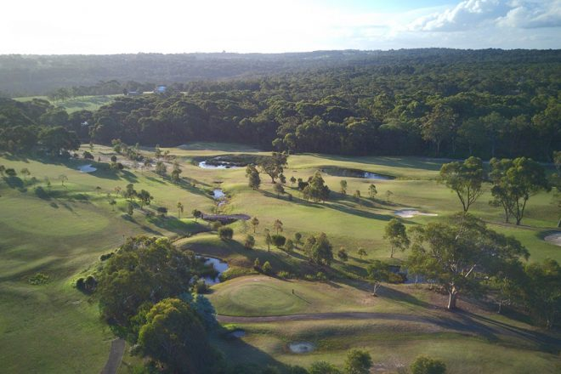
2022 Season Results

Slide 2
Season Review
25 Active Players
417 Rounds Completed
44 Competitions Completed
$2012 in Prizemoney won
At least 1,146,333 km’s walked

Slide 3

‘The Smoothest Roller’
17 Players met qualification criteria (10 starts)
Averages range from 15.19 → 19.38
This years winner:
  Scott Young (15.19) - $50

Slide 4

‘The Longest Wood’
15 Players secured at least 1 Longest Drive
Longest Drives ranged from 1 → 7
This years winner:
  Ben Robison (7) - $50

Slide 5
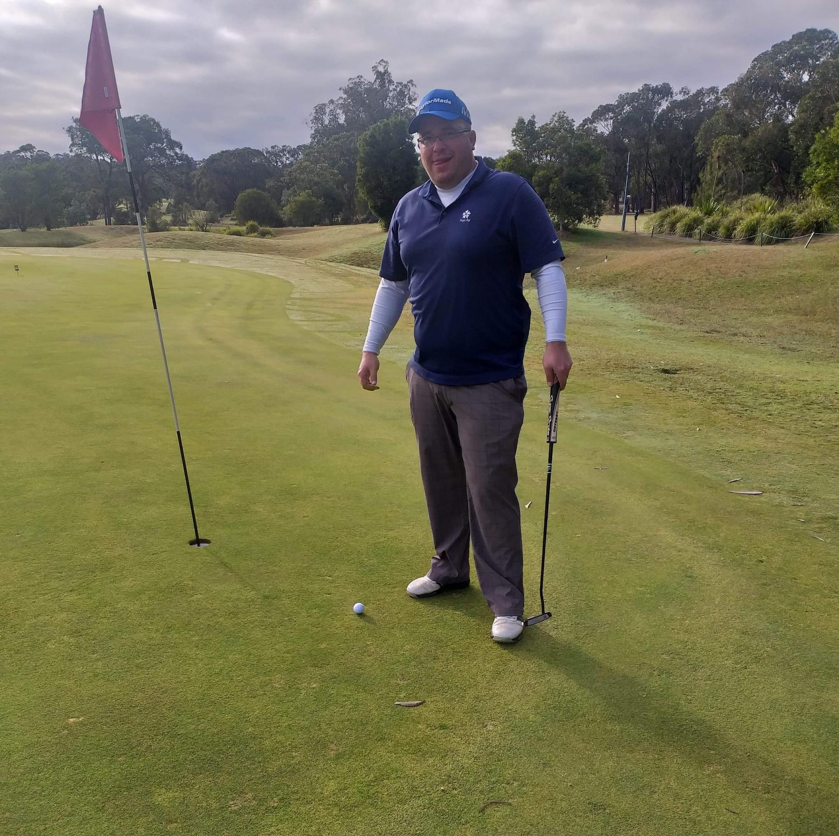
‘Dart Thrower’
20 Players secured at least 1 Nearest the Pin
Nearest the Pins ranged from 1 → 14
This years winner:
  Ben Robison (14) - $50

Slide 6

22nd Position
4 Games Played
Average of 60.25, with a PB of 57
1 Long Drive and 1 NTP
Averaging 19.25 putts
$9.50 prizemoney
Gus Alvarez

Slide 7
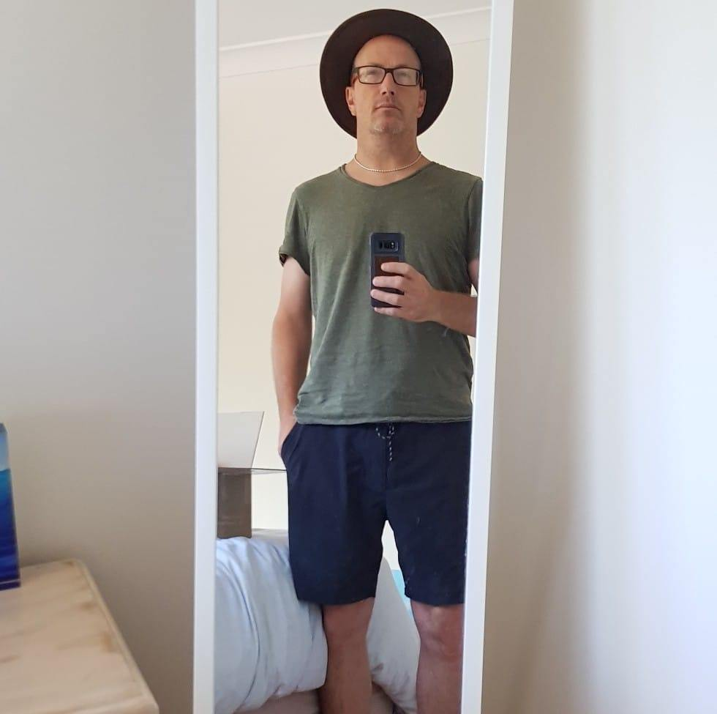
21st Position
5 Games Played
Average of 51.80, with a PB of 49
0 Long Drives and 0 NTP’s
Averaging 17.00 putts
$10.50 prizemoney
Scotty Henderson

Slide 8
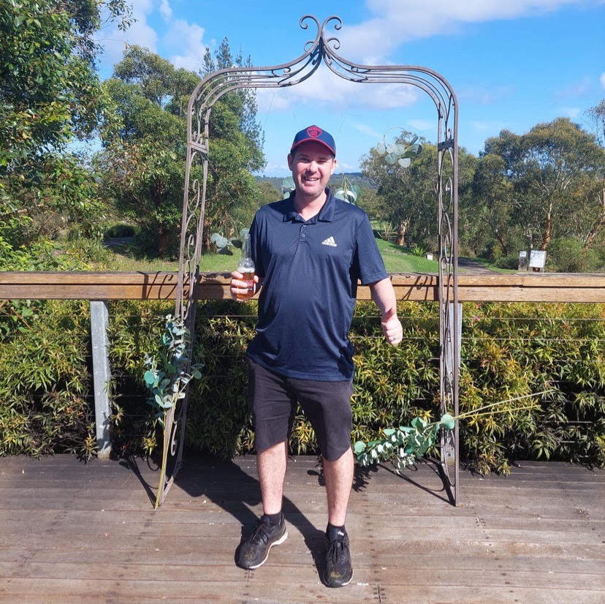
20th Position
4 Games Played
Average of 67.50, with a PB of 55
0 Long Drives and 1 NTP
Averaging 19.50 putts
1 Win for the season
$22.00 prizemoney
Stu Cameron

Slide 9

19th Position
9 Games Played
Average of 51.67, with a PB of 45
0 Long Drives and 2 NTP’s
Averaging 17.00 putts
1 Win for the season, and 2 Runner Up’s
$38.50 prizemoney
Mark Scicluna

Slide 10

18th Position
20 Games Played
Average of 61.05, with a PB of 52
3 Long Drives and 2 NTP’s
Averaging 17.50 putts
2 Wins for the season, and 1 Runner Up
$40.50 prizemoney
Trav Regent

Slide 11

17th Position
7 Games Played
Average of 52.14, with a PB of 43
0 Long Drives and 2 NTP’s
Averaging 16.29 putts
1 Wins for the season, and 0 Runner Up’s
$41.00 prizemoney
Daniel Curtis

Slide 12
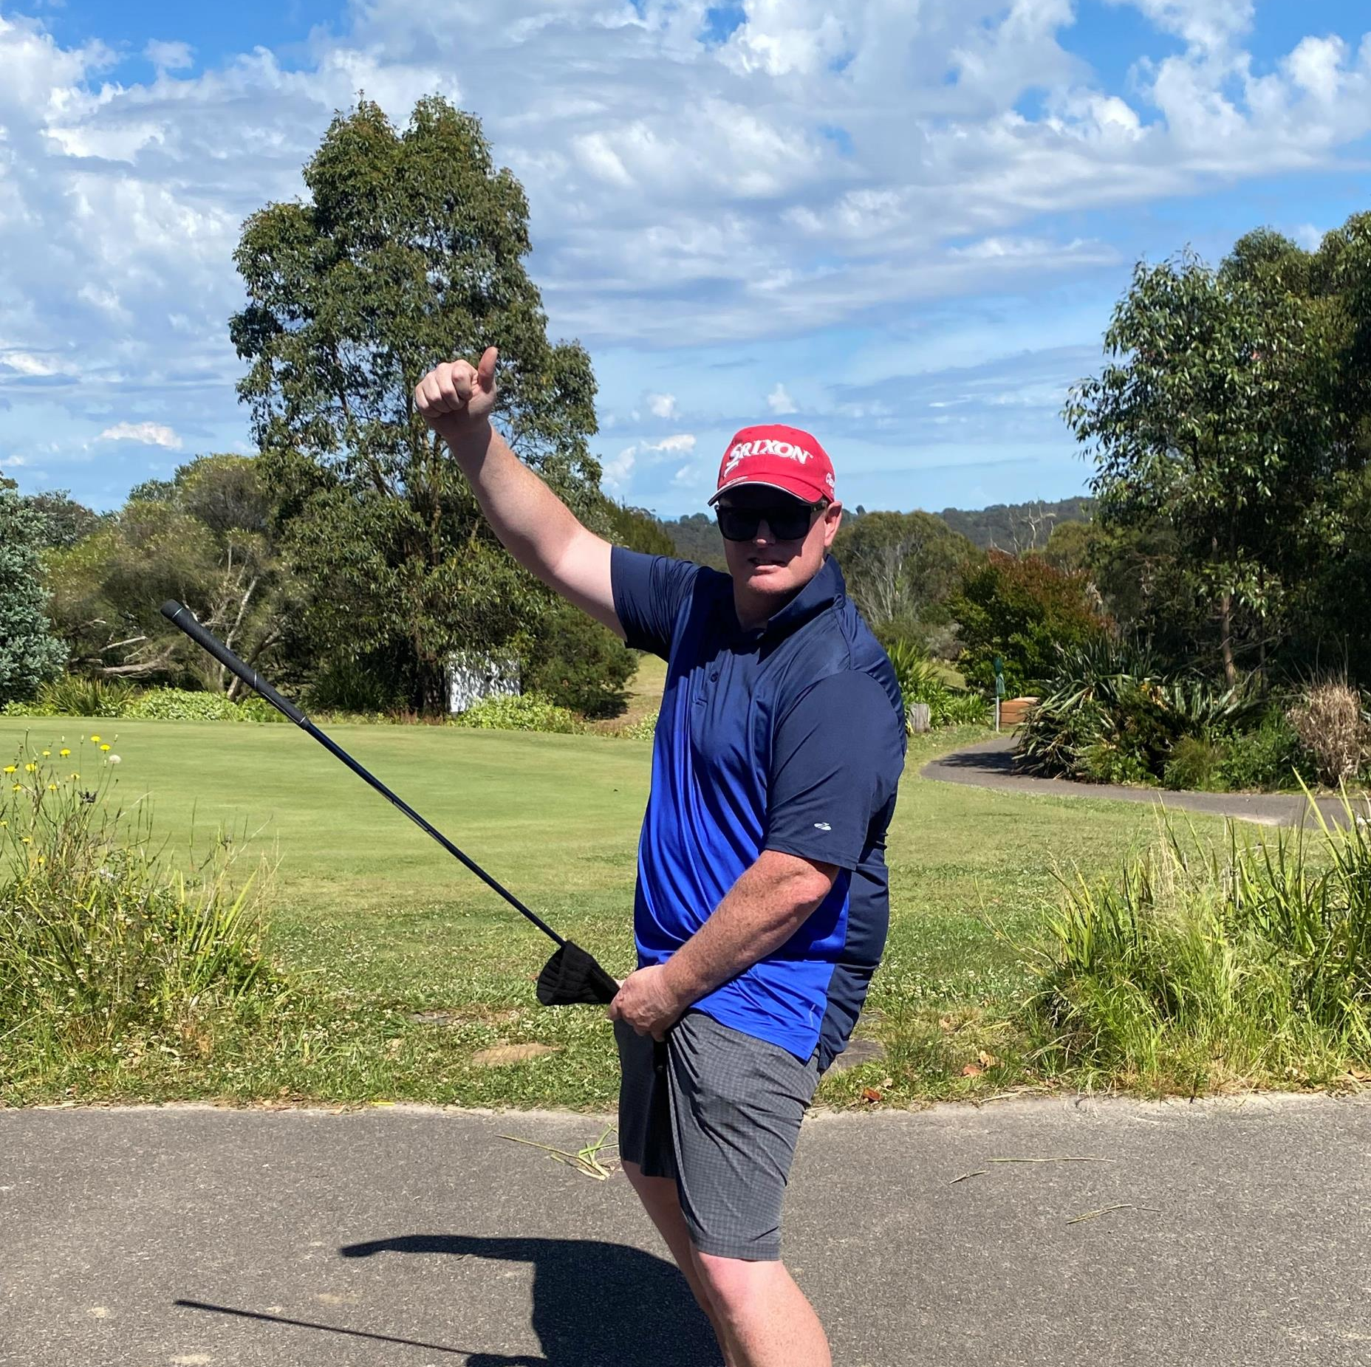
16th Position
12 Games Played
Average of 54.75, with a PB of 46
3 Long Drives and 0 NTP’s
Averaging 17.25 putts
2 Wins for the season, and 1 Runner Up’s
$47.50 prizemoney
Paul Hooke

Slide 13

15th Position
24 Games Played
Average of 53.29, with a PB of 48
0 Long Drives and 1 NTP’s
Averaging 16.25 putts
0 Wins for the season, and 7 Runner Up’s
$50.50 prizemoney
Shannon Roberts

Slide 14
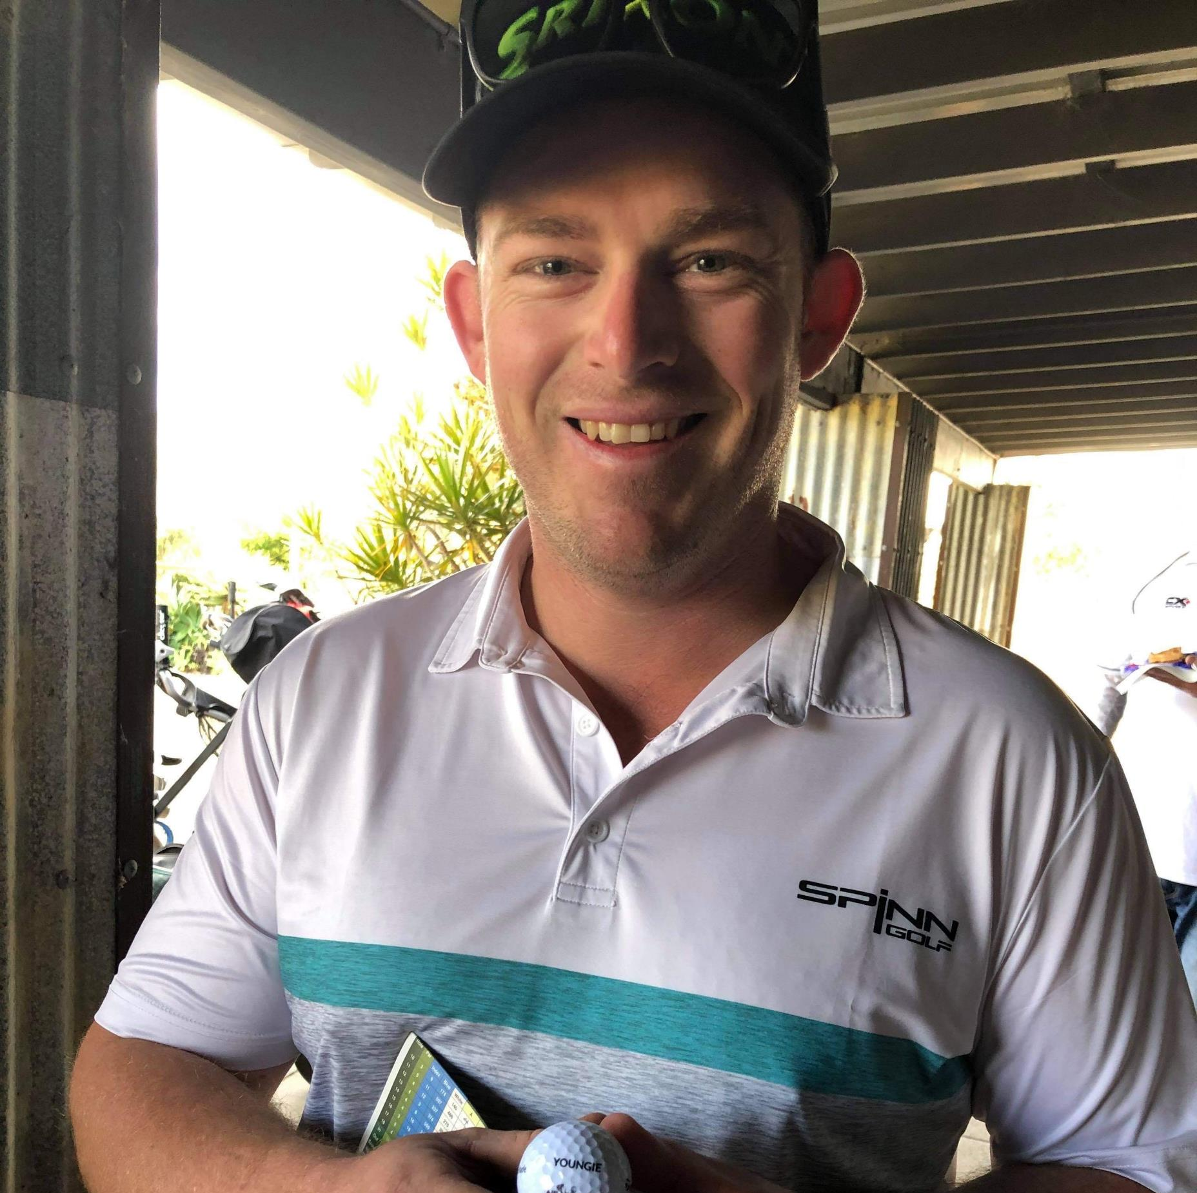
14th Position
4 Games Played
Average of 49.25, with a PB of 47
0 Long Drives and 1 NTP’s
Averaging 16.75 putts
1 Win for the season, and 2 Runner Up’s
$57.50 prizemoney
Ryan McBride

Slide 15
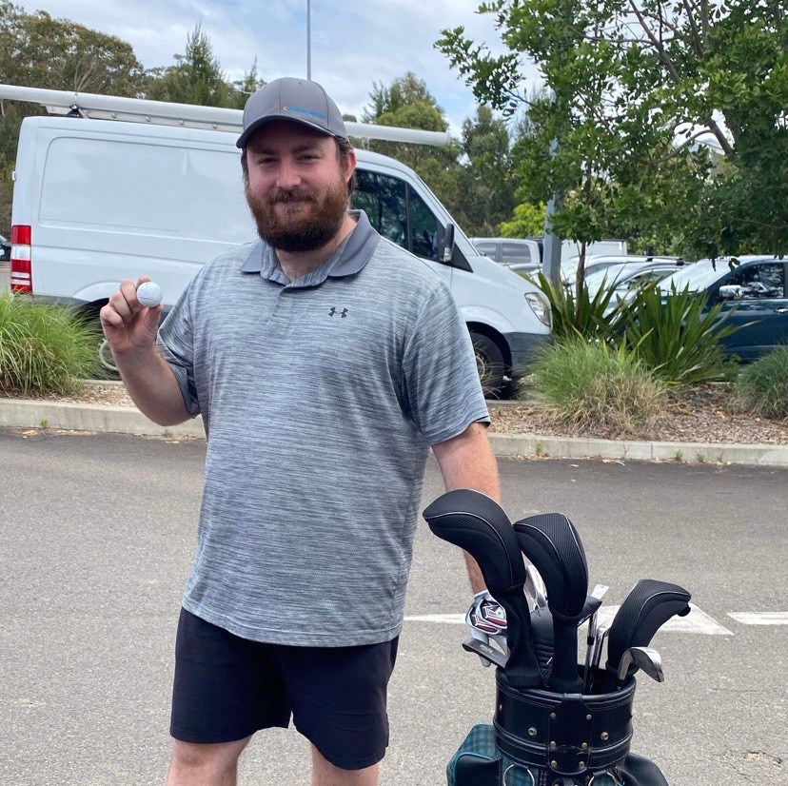
13th Position
18 Games Played
Average of 58.50, with a PB of 51
1 Long Drive and 2 NTP’s
Averaging 17.72 putts
2 Wins for the season, and 3 Runner Up’s
$62.50 prizemoney
Jake Buckley

Slide 16
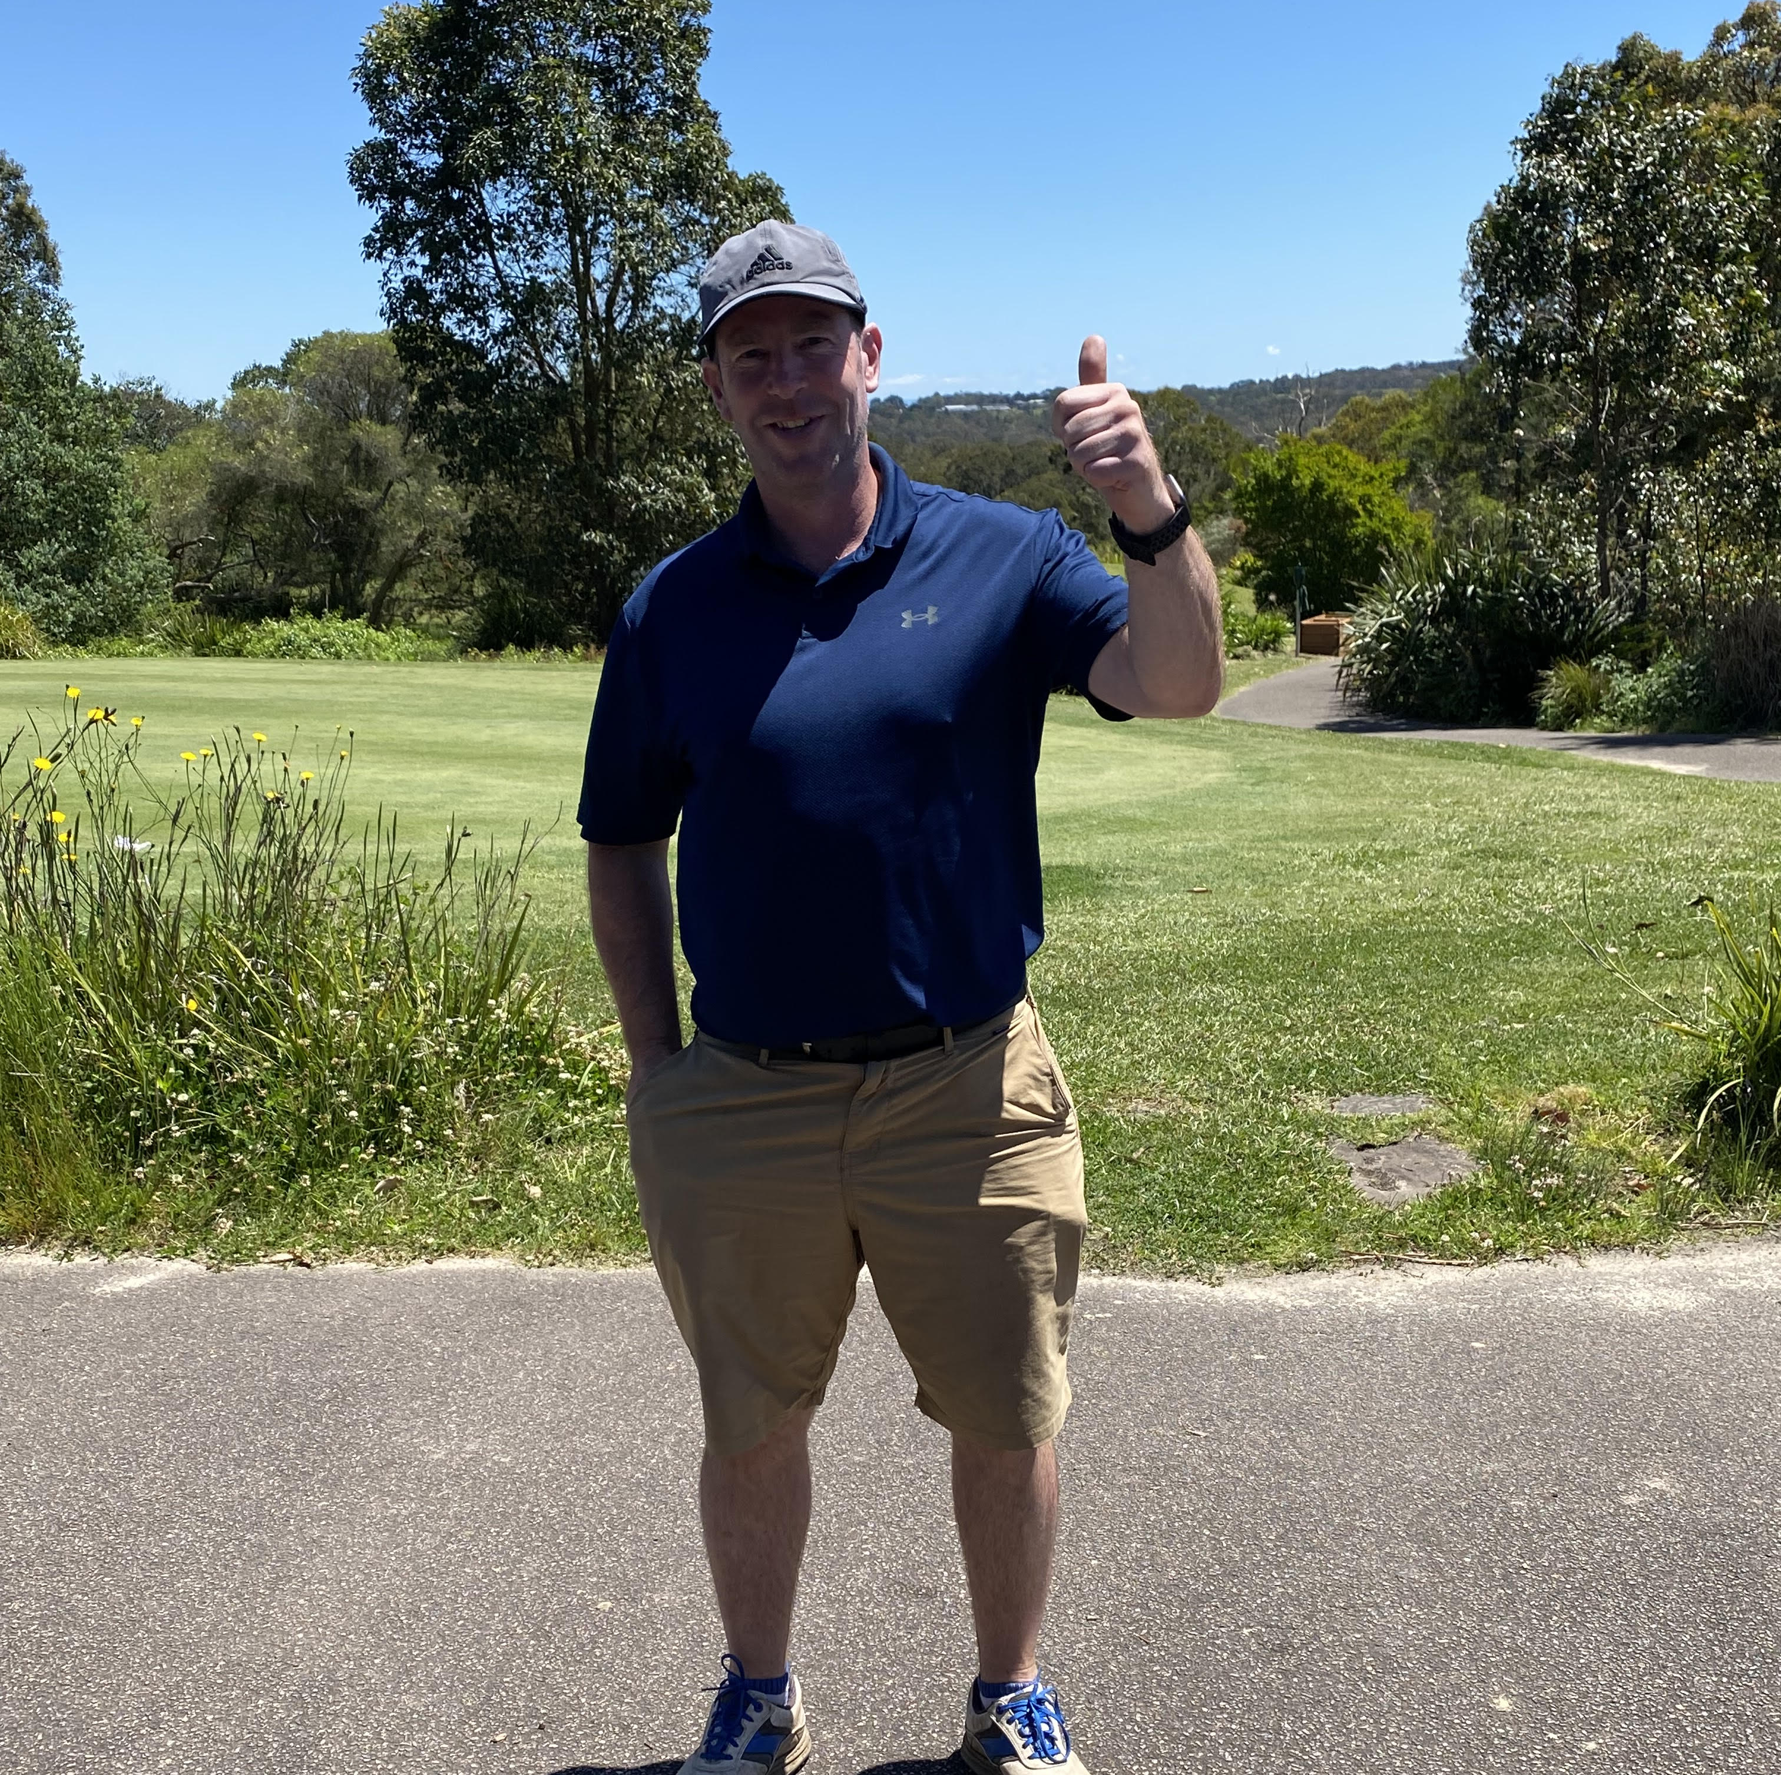
12th Position
16 Games Played
Average of 46.13, with a PB of 39
1 Long Drive and 1 NTP
Averaging 16.00 putts
2 Wins for the season, and 2 Runner Up’s and 1 Stableford victory
$63.50 prizemoney
Mike Folland

Slide 17
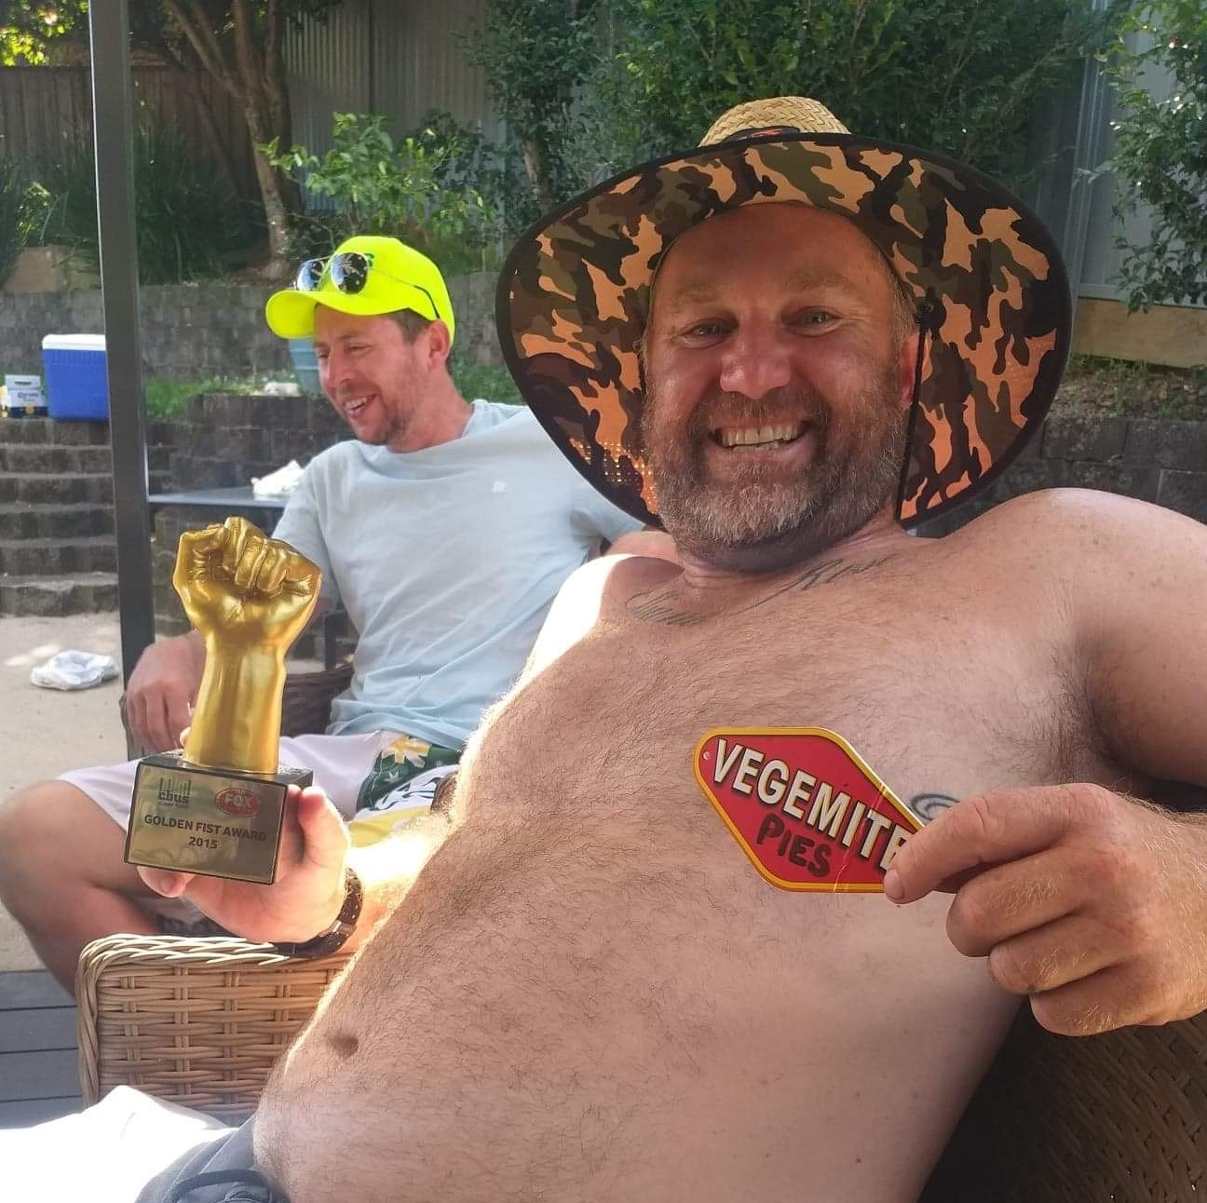
11th Position
17 Games Played
Average of 51.24, with a PB of 46
2 Long Drive and 4 NTP’s
Averaging 17.76 putts
1 Win for the season, and 2 Runner Up’s
$64.00 prizemoney
Mick Tandy

Slide 18
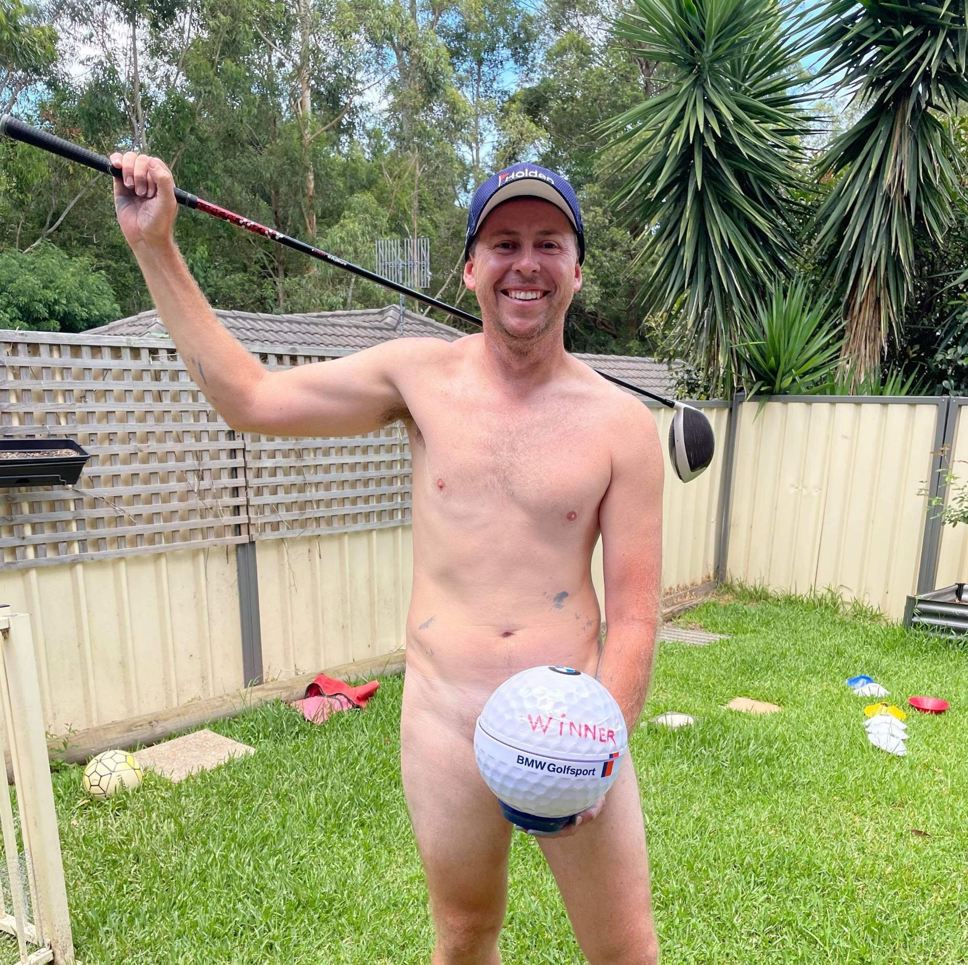
10th Position
13 Games Played
Average of 46.00, with a PB of 40
1 Long Drive and 3 NTP’s
Averaging 16.15 putts
0 Wins for the season, and 4 Runner Up’s
$71.00 prizemoney
Justin Daley

Slide 19

9th Position
18 Games Played
Average of 55.44, with a PB of 50
2 Long Drive and 7 NTP’s
Averaging 17.11 putts
2 Wins for the season, 0 Runner Up’s and 1 Stableford victory
$72.00 prizemoney
Brad Campbell

Slide 20
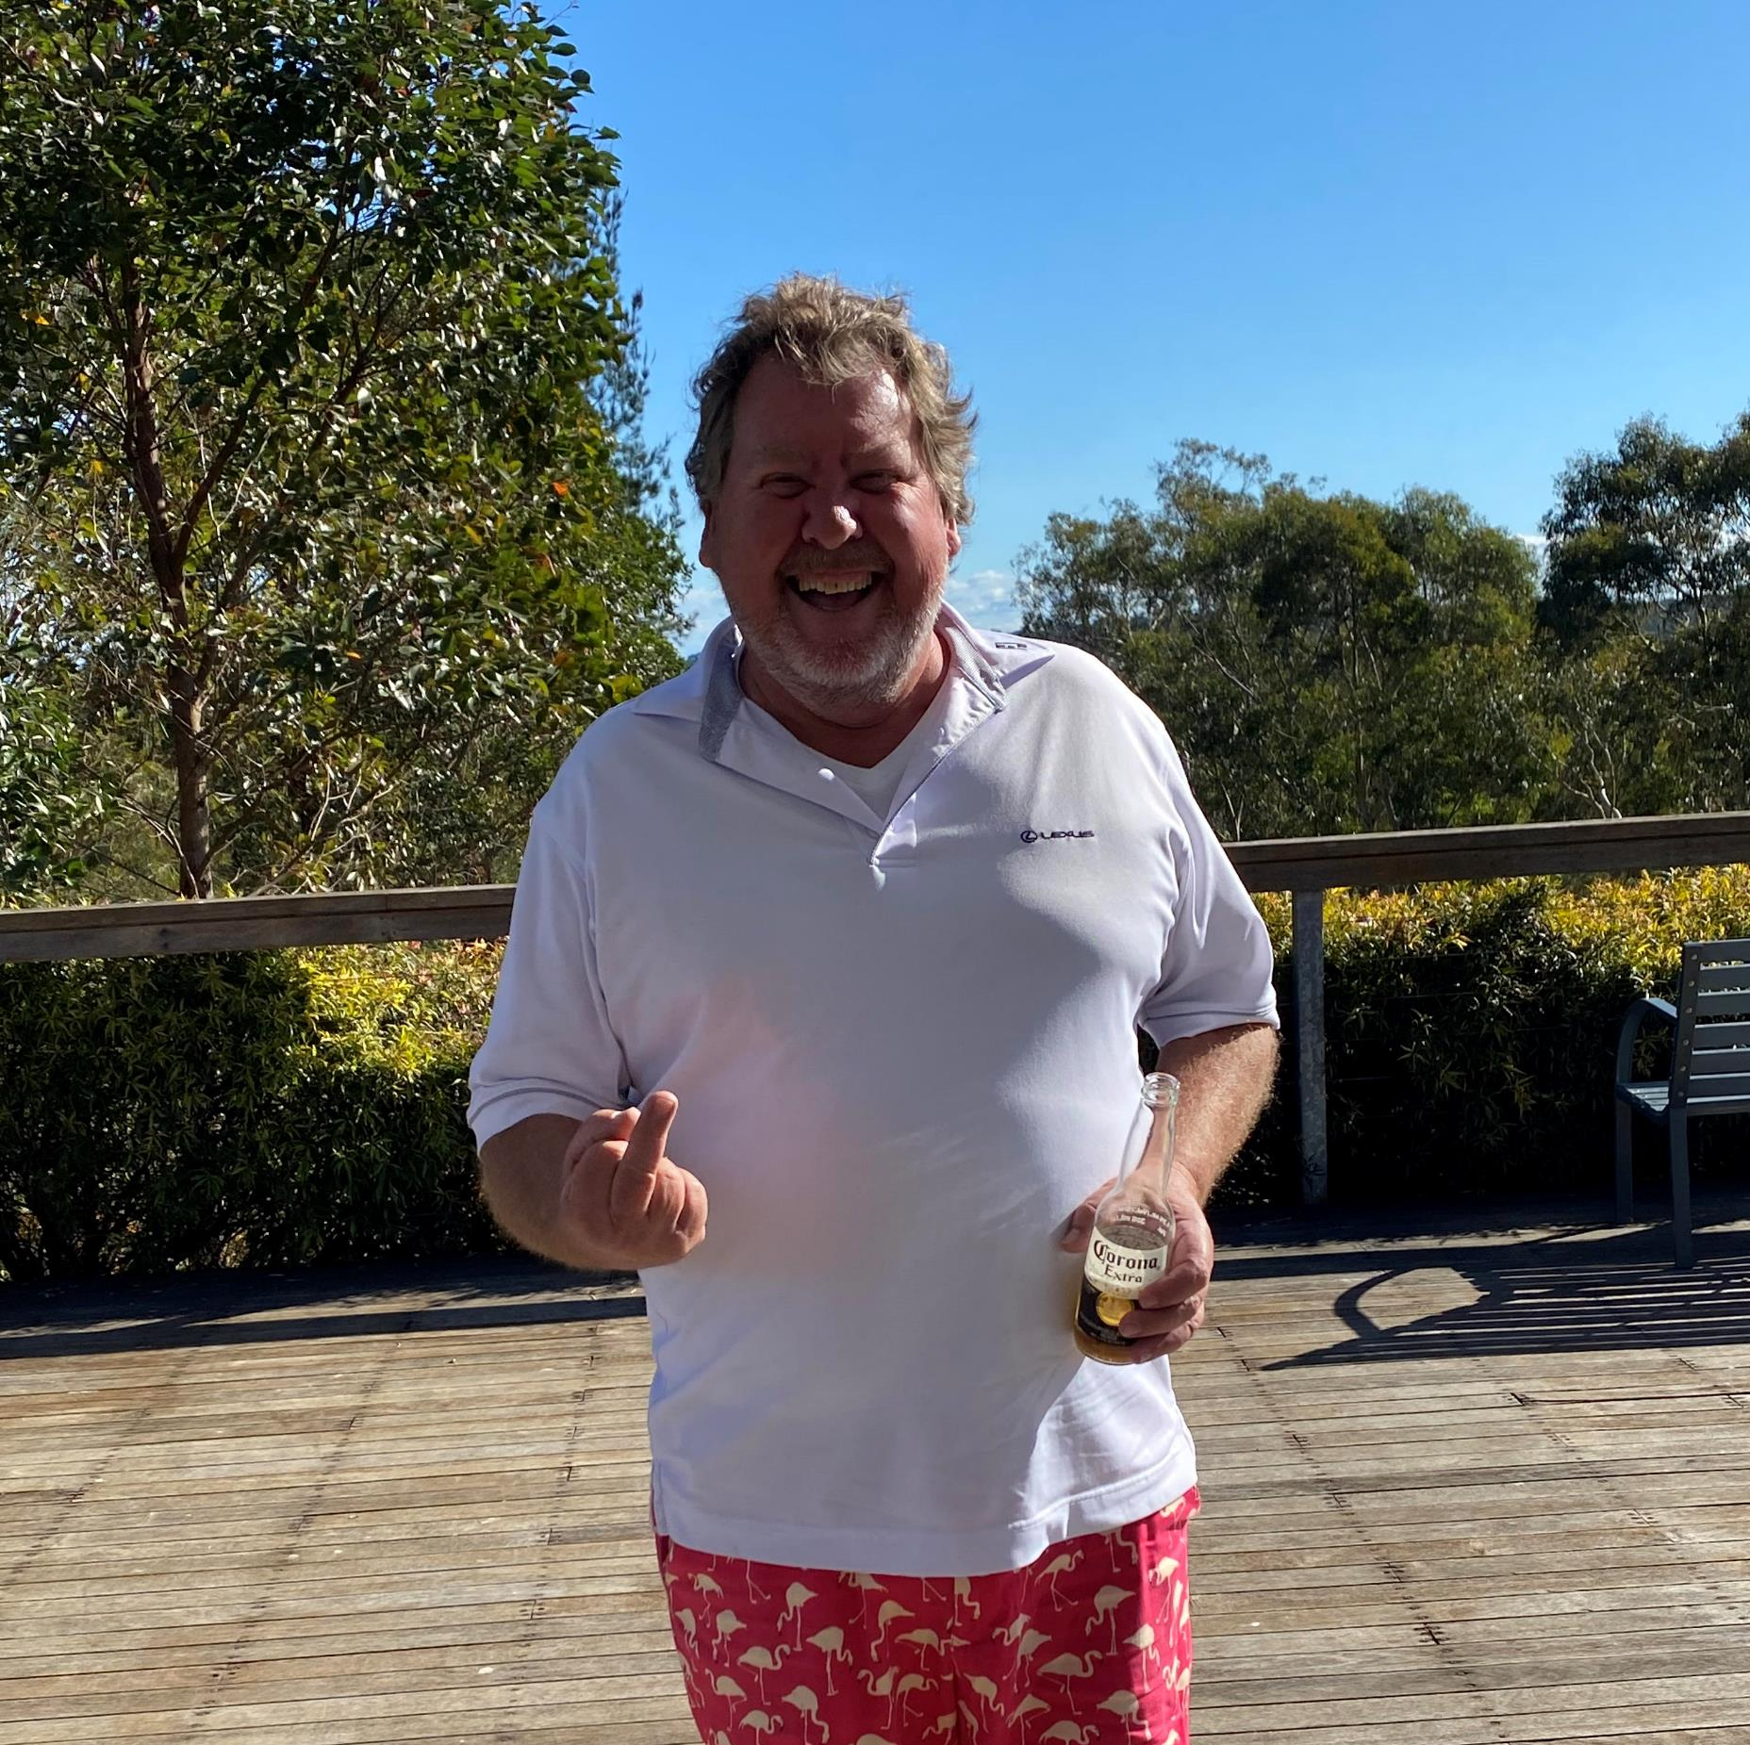
8th Position
32 Games Played
Average of 58.91, with a PB of 50
2 Long Drive and 1 NTP
Averaging 19.34 putts
2 Wins for the season, 4 Runner Up’s and 2 Stableford victories
$87.00 prizemoney
Lee Carnell

Slide 21
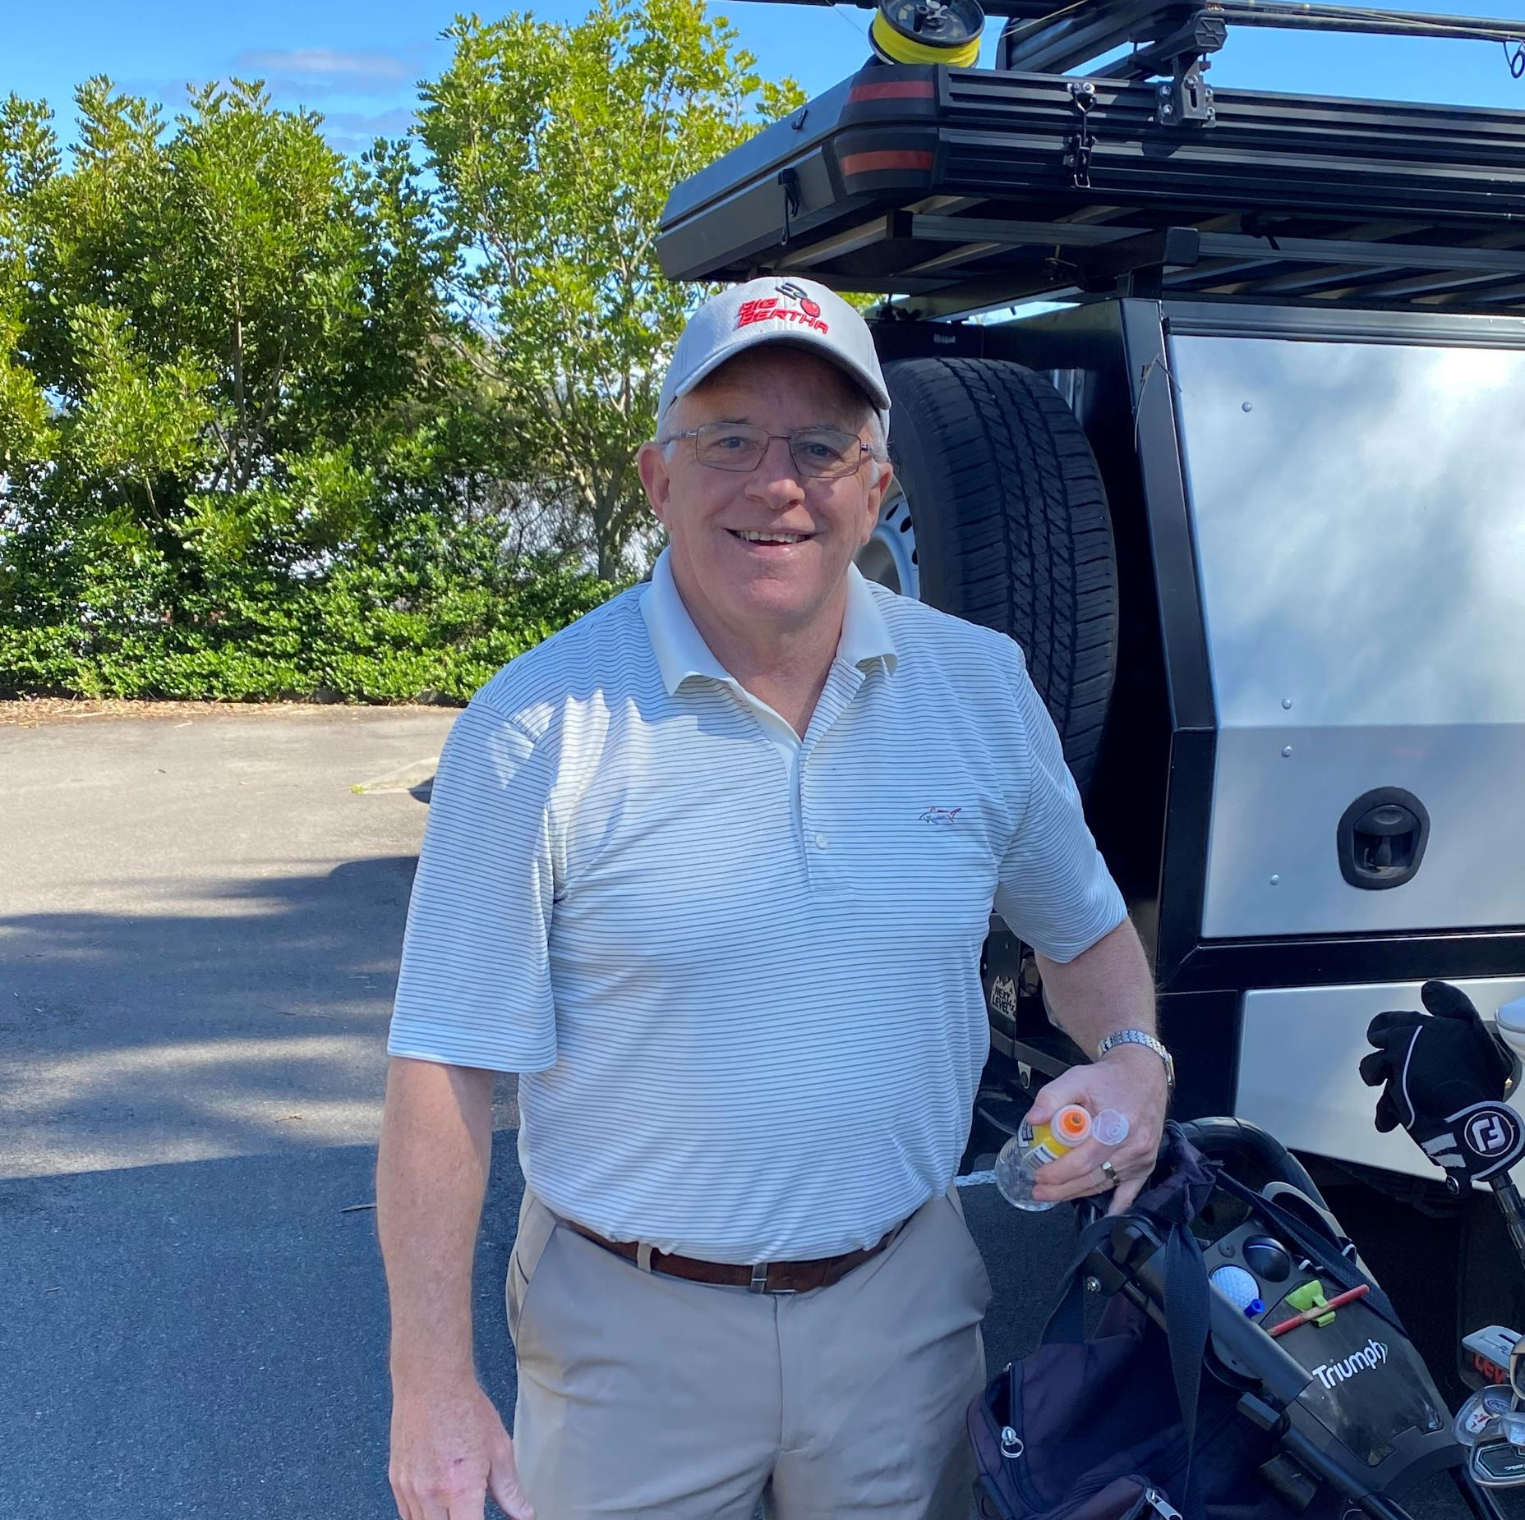
7th Position
34 Games Played
Average of 58.76, with a PB of 49
2 Long Drive and 3 NTP’s
Averaging 19.38 putts
4 Wins for the season, and 2 Runner Up’s
$94.50 prizemoney
Peter Robison

Slide 22

6th Position
33 Games Played
Average of 55.52, with a PB of 44
2 Long Drive and 4 NTP’s
Averaging 17.06 putts
2 Wins for the season, 0 Runner Up’s and 1 Stableford victory
$106.00 prizemoney
Shannon Kelderman

Slide 23
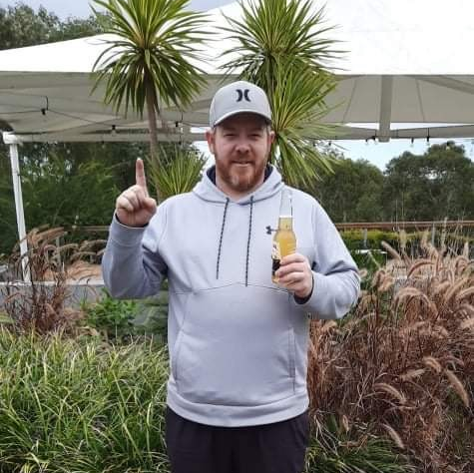
5th Position
30 Games Played
Average of 54.60, with a PB of 44
0 Long Drive and 7 NTP’s
Averaging 17.27 putts
5 Wins for the season, 1 Runner Up and 1 Stableford victory
$148.50 prizemoney
Dan Magill

Slide 24

4th Position
25 Games Played
Average of 47.76, with a PB of 40
4 Long Drive and 11 NTP’s
Averaging 17.24 putts
5 Wins for the season, and 3 Runner Up’s
$187.00 prizemoney
Matt Bezzina

Slide 25

3rd Position
34 Games Played
Average of 51.47, with a PB of 45
5 Long Drive and 10 NTP’s
Averaging 17.82 putts
6 Wins for the season, 4 Runner Up’s and 1 Stableford victory
$215.00 prizemoney
Ben Williams

Slide 26

Runner Up
16 Games Played
Average of 41.13, with a PB of 35
4 Long Drive and 7 NTP’s
Averaging 15.19 putts ($50 bonus)
3 Wins for the season, and 2 Runner Up’s
$230.00 prizemoney
Scott Young

Slide 27
Grand Champion 2022
37 Games Played
Average of 48.27, with a PB of 40
7 Long Drive and 14 NTP’s ($50 bonus x 2)
Averaging 16.13 putts
2 Wins for the season, and 3 Runner Up’s
$293.50 prizemoney
Ben Robison

Slide 28


